Slide 1
HIGH PERFORMANCE COMPUTING WITH ACCELERATORS
Name – Sakil Mallick
Roll No. – 001510501050
BCSE - IV

Slide 2
Agenda
Introduction
A Bit of History
State of Affairs
Why Accelerators
Accelerators
Accelerator Features
High Performance Computing Considerations
General purpose Graphical Processing units (GPGPUs)
Field Programmable Gate arrays( FPGAs)
Clear Speed Floating point accelerators
IBM Cell processors
Advantages & Drawbacks
Future of Application Accelerators in HPC
References

Slide 3
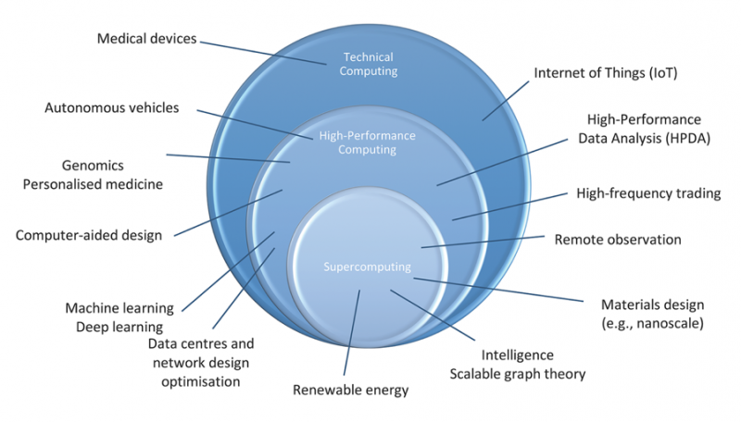
Introduction
High-performance computing (HPC) uses supercomputers and computer clusters to solve advanced computation problems.
Today, computer systems approaching the teraflops-region are counted as HPC-computers. The term is most commonly associated with computing used for scientific research or computational science.
Recently, HPC has come to be applied to business uses of cluster-based supercomputers, such as data warehouses, line-of-business (LOB) applications, and transaction processing.

Slide 4
A Bit of History
Application accelerator is not a new concept
• e.g., Intel C8087 Math Coprocessor
But it received a renewed interest around 2002 due to the single thread performance stall
• Frequency scaling became unsustainable with smaller IC feature sizes
• Instruction-level parallelism (IPL) can go only so far

Slide 5
State of Affairs
With the introduction of application accelerators, new languages and programming models are emerging that eliminate the option to port code between "standard" and "nonstandard" architectures.
The community fears that these new architectures will result in the creation of many code branches that are not compatible or portable. Mature codes have also been extensively validated and trusted in the community; porting them to newly emerging accelerator architectures will require yet another round of validation.
In contrast, early adopters argue that existing HPC resources are insufficient—at least for their applications—and they're willing to rewrite their codes to take advantage of the new systems' capabilities. They're concerned about (but willing to endure) the complexity of porting existing codes or rewriting them from scratch for the new architectures.

Slide 6
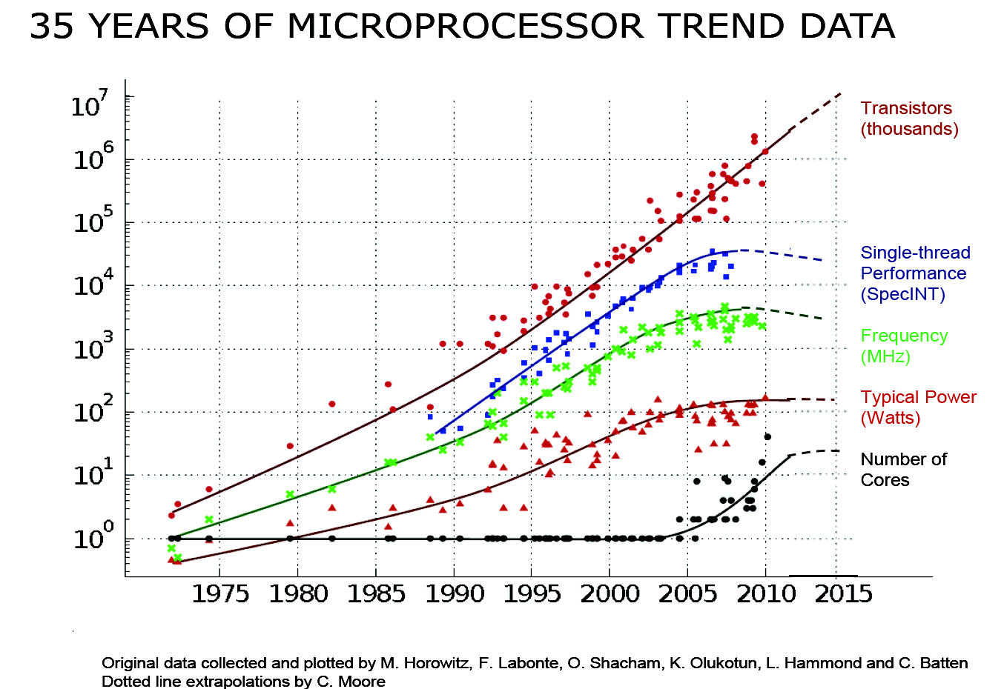
Why Accelerators
For many years microprocessor single thread performance has increased at rates consistent with Moore’s Law for transistors.
Clock speeds are now improving slowly and microprocessor vendors are increasing the number of cores per chip to obtain improved performance.
This approach is not allowing microprocessors to increase single thread performance at the rates customers have come to expect.

Slide 7
Accelerators
Types of accelerators in use:
General Purpose Graphical Processing Units (GPGPUs)
Field Programmable Gate Arrays (FPGAs) boards
ClearSpeed’s floating-point boards
IBM’s Cell processors

Slide 8
Accelerators
Characteristics of ideal accelerators:
Much faster than standard microprocessors for typical HPC workloads
Improves price/performance
Improves performance/watt
Is easy to program

Slide 9
Accelerator Features
Accelerators are computing components containing functional units, together with memory and control systems that can be easily added to computers to speed up portions of applications. They can also be aggregated into groups for supporting acceleration of larger problem sizes. Each accelerator being investigated has many (but not necessarily all) of the following features.
A slow clock period compared to CPUs
Aggregate high performance is achieved through parallelism
Transferring data between the accelerators and CPUs is slow compared to the memory bandwidth available for the primary processors
Needs lots of data reuse for good performance
The fewer the bits, the better the performance
Integer is faster than 32-bit floating-point which is faster than 64-bit floating-point
Learning the theoretical peak is difficult
Software tools lacking
Requires programming in languages designed for the particular technology

Slide 10
High Performance Computing Considerations
Price/performance (want to increase Gflop/s / $) – the more costly the accelerator, the faster it must be to succeed.
Computational density for system (want to increase Gflop/s / cubic meter) – accelerators can improve this significantly.
Power considerations (want to increase Gflop/s / watt) – some technologies require very little power while other require so much they can’t be used in low power systems.
Cluster system Mean Time Between Failure (want to increase Gflop/s * MTBF) – if accelerators allow a reduction in node count, the MTBF may improve significantly.

Slide 11
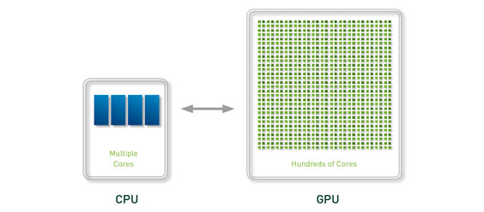
General purpose Graphical Processing units (GPGPUs)
General-purpose GPU computing or GPGPU computing is the use of a GPU (graphics processing unit) to do general purpose scientific and engineering computing.
The model for GPU computing is to use a CPU and GPU together in a heterogeneous co-processing computing model. The sequential part of the application runs on the CPU and the computationally-intensive part is accelerated by the GPU. From the user’s perspective, the application just runs faster because it is using the high-performance of the GPU to boost execution.

Slide 12
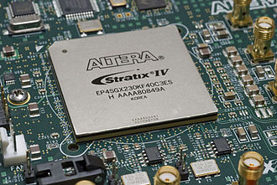
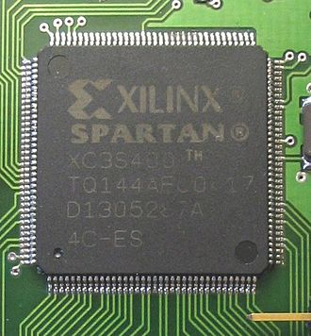
Field Programmable Gate arrays( FPGAs)
A field-programmable gate array (FPGA) is an integrated circuit designed to be configured by a customer or a designer after manufacturing – hence "field-programmable".
CPU socket plug-ins and PCI-based accelerator boards offered by a number of vendors
A Stratix IV FPGA from Altera A Spartan FPGA from Xilinx

Slide 13
Clear Speed Floating point accelerators
ClearSpeed Technology produces a board that is designed to accelerate floating-point calculations.
This board plugs into a PCI-X slot, has a clock cycle of 500 MHz, and contains 96 floating-point functional units that can each perform a double precision multiply-add in one cycle.
In stark contrast to nVidia and ATI/AMD ClearSpeed offered single and double precision from the very beginning, aiming specifically at general purpose computational acceleration but at a cost.
One of the key ClearSpeed points is very low power and therefore potential for very high computing density.

Slide 14
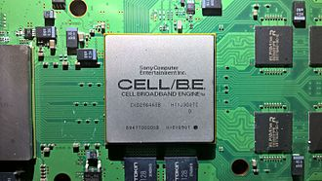
IBM Cell processors
Cell is a multi-core microprocessor microarchitecture that combines a general-purpose Power Architecture core of modest performance with streamlined coprocessing elements which greatly accelerate multimedia and vector processing applications, as well as many other forms of dedicated computation. Cell is shorthand for Cell Broadband Engine Architecture, commonly abbreviated CBEA in full or Cell BE in part.
Cell BE as it appears in the PS3 on the motherboard

Slide 15
Advantages & Drawbacks
There are multiple families of accelerators suitable for executing applications from portions of HPC space. These include GPGPUs, FPGAs, ClearSpeed and the Cell processor. Each type is good for specific types of applications, but they all need applications with a high calculation to memory reference ratio.
They are best at the following:
GPGPUs: graphics, 32-bit floating-point
FPGAs: embedded applications, applications that require a small number of bits
ClearSpeed: matrix-matrix multiplication, 64-bit floating-point
Cell: graphics, 32-bit floating-point
Common traits for accelerators today include slow clock frequencies, performance is through parallelism, low bandwidth connections to CPU, and the lack of standard software tools.

Slide 16
Future of Application Accelerators in HPC
Application accelerators will continue to play a role in HPC
• Cost, power, and size are the driving forces and application accelerators have an advantage
HPC clusters with application accelerators will continue to be the dominant architecture
GPUs will continue to dominate the accelerator market
• NVIDIA has a GPU product line specifically designed for HPC
New major deployments are coming
• NSF Track 2D system, Keeneland
New accelerator architectures are coming
• Intel Many Integrated Core (MIC) architecture, AMD Fusion
We are starting to see more and more HPC applications ported to accelerators

Slide 17
References
https://ieeexplore.ieee.org/document/5492949
https://www.researchgate.net/publication/224148910_High-Performance_Computing_with_Accelerators
http://www.ncsa.illinois.edu/People/kindr/projects/hpca/
V. Kindratenko, High Performance Computing with Application Accelerators, High Performance Computing Symposium, June 2010, Advanced Digital Sciences Center, Singapore
V. Kindratenko, High Performance Computing with Accelerators, First workshop of the Joint Laboratory for Petascale Computing, June 2009, Paris, France

